Slide 1

MICRO credit
Microfinance is a banking service provided to unemployed or low-income individuals or groups who otherwise would have no other access to financial services. Microfinance allows people to take on reasonable small business loans safely, and in a manner that is consistent with ethical lending practices.
By:
Trapti Dubey

Slide 2
Introduction
Indonesia has one of the largest unbanked populations in the world (about 64% unbanked) (World Bank, 2014), with more than 81 per cent of its population earning less thanUS$4.50 a day (World Bank Estimates). As such, it has had a long history of microcredit programs dating back more than 100 years (KPMG Indonesia, 2015). Some industry experts estimate that there are more than 36 million microfinance borrowers through Indonesia’s diverse institutions, programs, services setup by both government and nongovernmental groups. The Indonesian microfinance market is split between two segments: one segment is covered by regulated micro-finance providers such as commercial banks such as Bank Rakyat Indonesia (BRI) and rural banks or Bank Perkreditan Rakyat (BPR) focused on districts and sub-district towns; the other segment is covered by NGOs, co-operatives, and village based institutions referred to as Badan Kredit Desa (BKD) and Lembaga Dana Kredit Pedesaan (LDKP) focused on the lower end of the market with some reach to remote rural areas

Slide 3
Project topic
We are working with client that is in Telecom Industry .They have launched various products and have developed its business and organization based on the budget operator model, offering better products at Lower Prices to all value conscious customers through a strategy of disruptive innovation that focuses on the subscriber.
Telecom Industry understand the importance of communication and how it affects a person’s life, thus, focusing on providing their services and products to low income families and poor customers that can help them in the need of hour.
They are collaborating with an MFI to provide micro-credit on mobile balances to be paid back in 5 days. The Consumer is believed to be defaulter if he deviates from the path of paying back the loaned amount within the time duration of 5 days. For the loan amount of 5 (in Indonesian Rupiah), payback amount should be 6 (in Indonesian Rupiah), while, for the loan amount of 10 (in Indonesian Rupiah), the payback amount should be 12 (in Indonesian Rupiah).

Slide 4
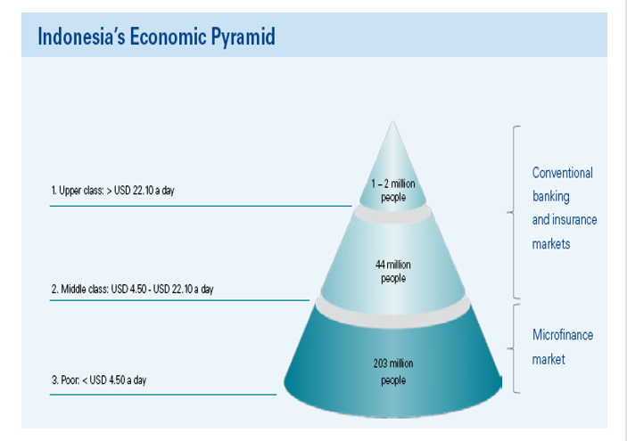
Indonesian economic
203 million, or 81.5% of Indonesians are at the bottom of the economic pyramid
Microfinance involves the supply of financial services to poor or low-income earning individuals and companies, which may include micro-credit.
In Indonesia the banks and MFI :
1195 commercial banks
1,6435 rural banks
Up to 600,0006 other Micro finance institutions (MFIs)

Slide 5
Project goals
Analytical Problem Framing
EDA
Visualizations
Data Pre-processing on Train & test dataset
Model development and Evaluation
Performing Hyper-parameter Tuning
Best Fit Model and prediction
Conclusion

Slide 6
Exploratory data analysis
This section shows the exploration done on the dataset, which is what motivated the use of the algorithm.
A significant relationship between Non-defaulter & defaulter.
Dataset is imbalanced. Label ‘1’ has approximately 87.5% records, while, label ‘0’ has approximately 12.5% records.
Training phase: The system is trained by using the data set and fits a model
Testing phase: The system is provided with the inputs and is tested for its working. The accuracy is checked

Slide 7
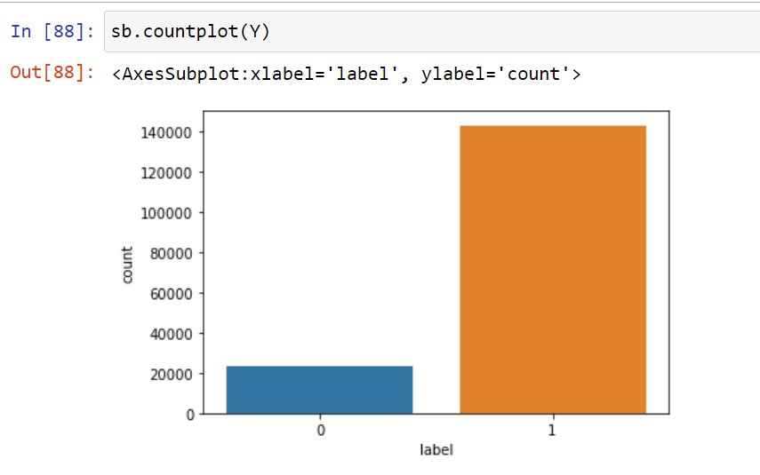
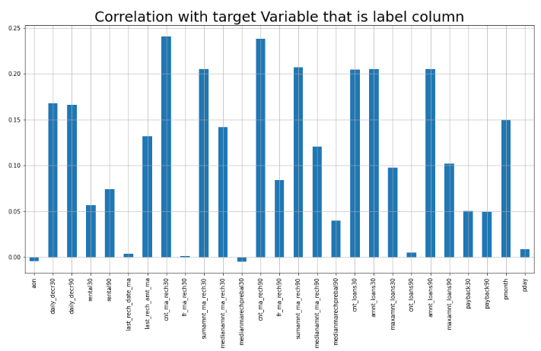
Visualizations

Slide 8
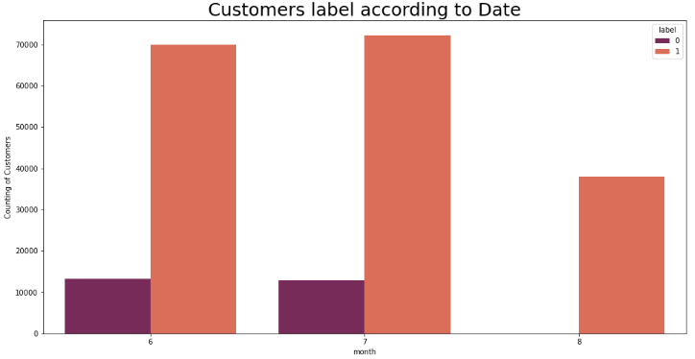
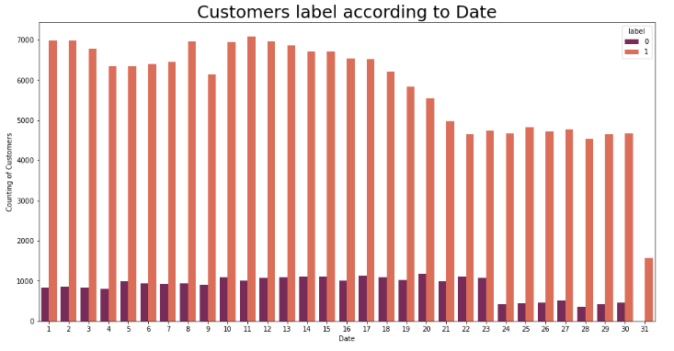
Loan count as per date and month (Non-defaulter and Defaulter):

Slide 9
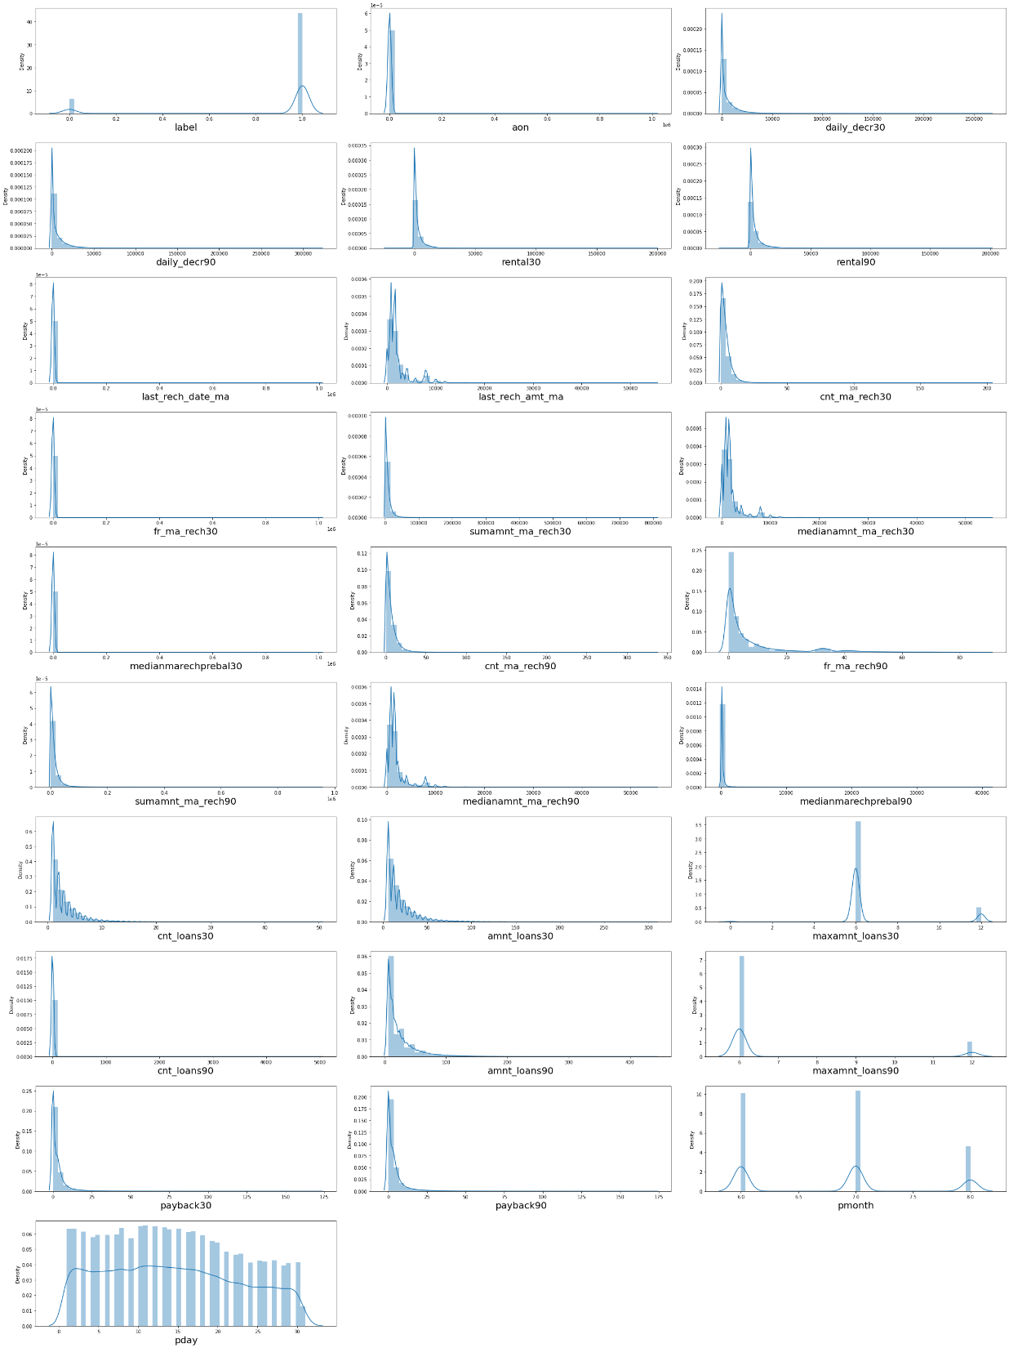
Multivariate Analysis
Distribution plot to check through all the column details ensuring that the distribution is displayed for further analysis

Slide 10
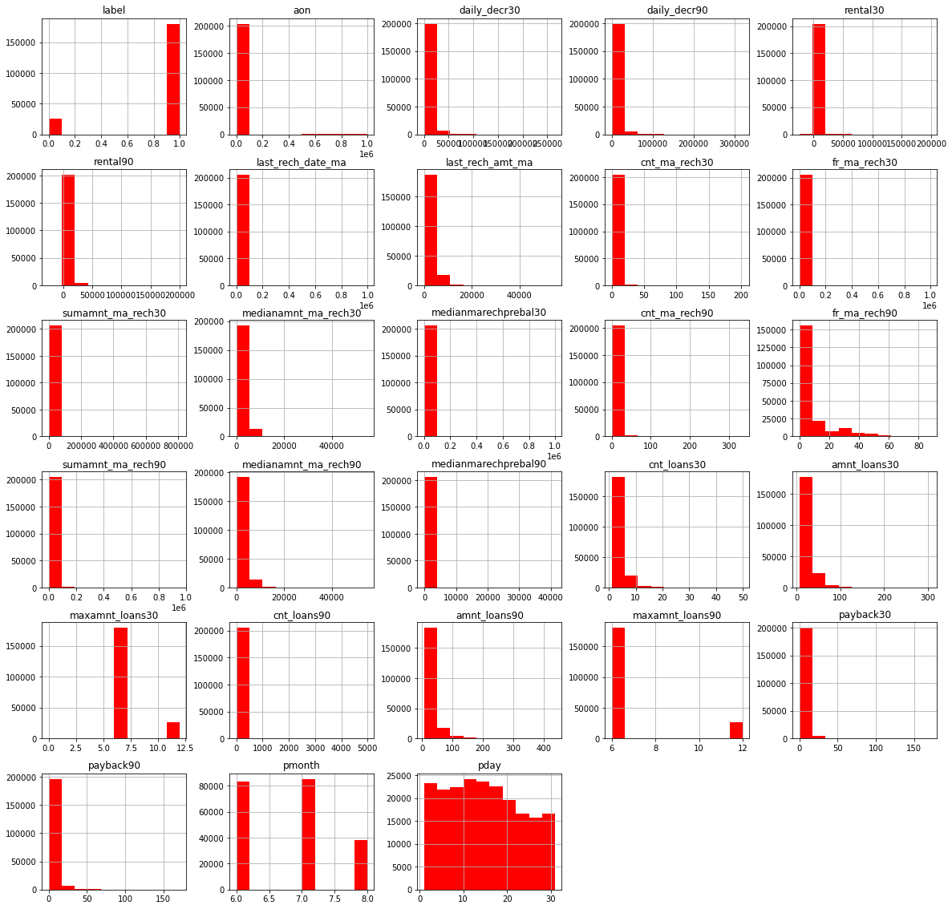
Plotting histogram

Slide 11
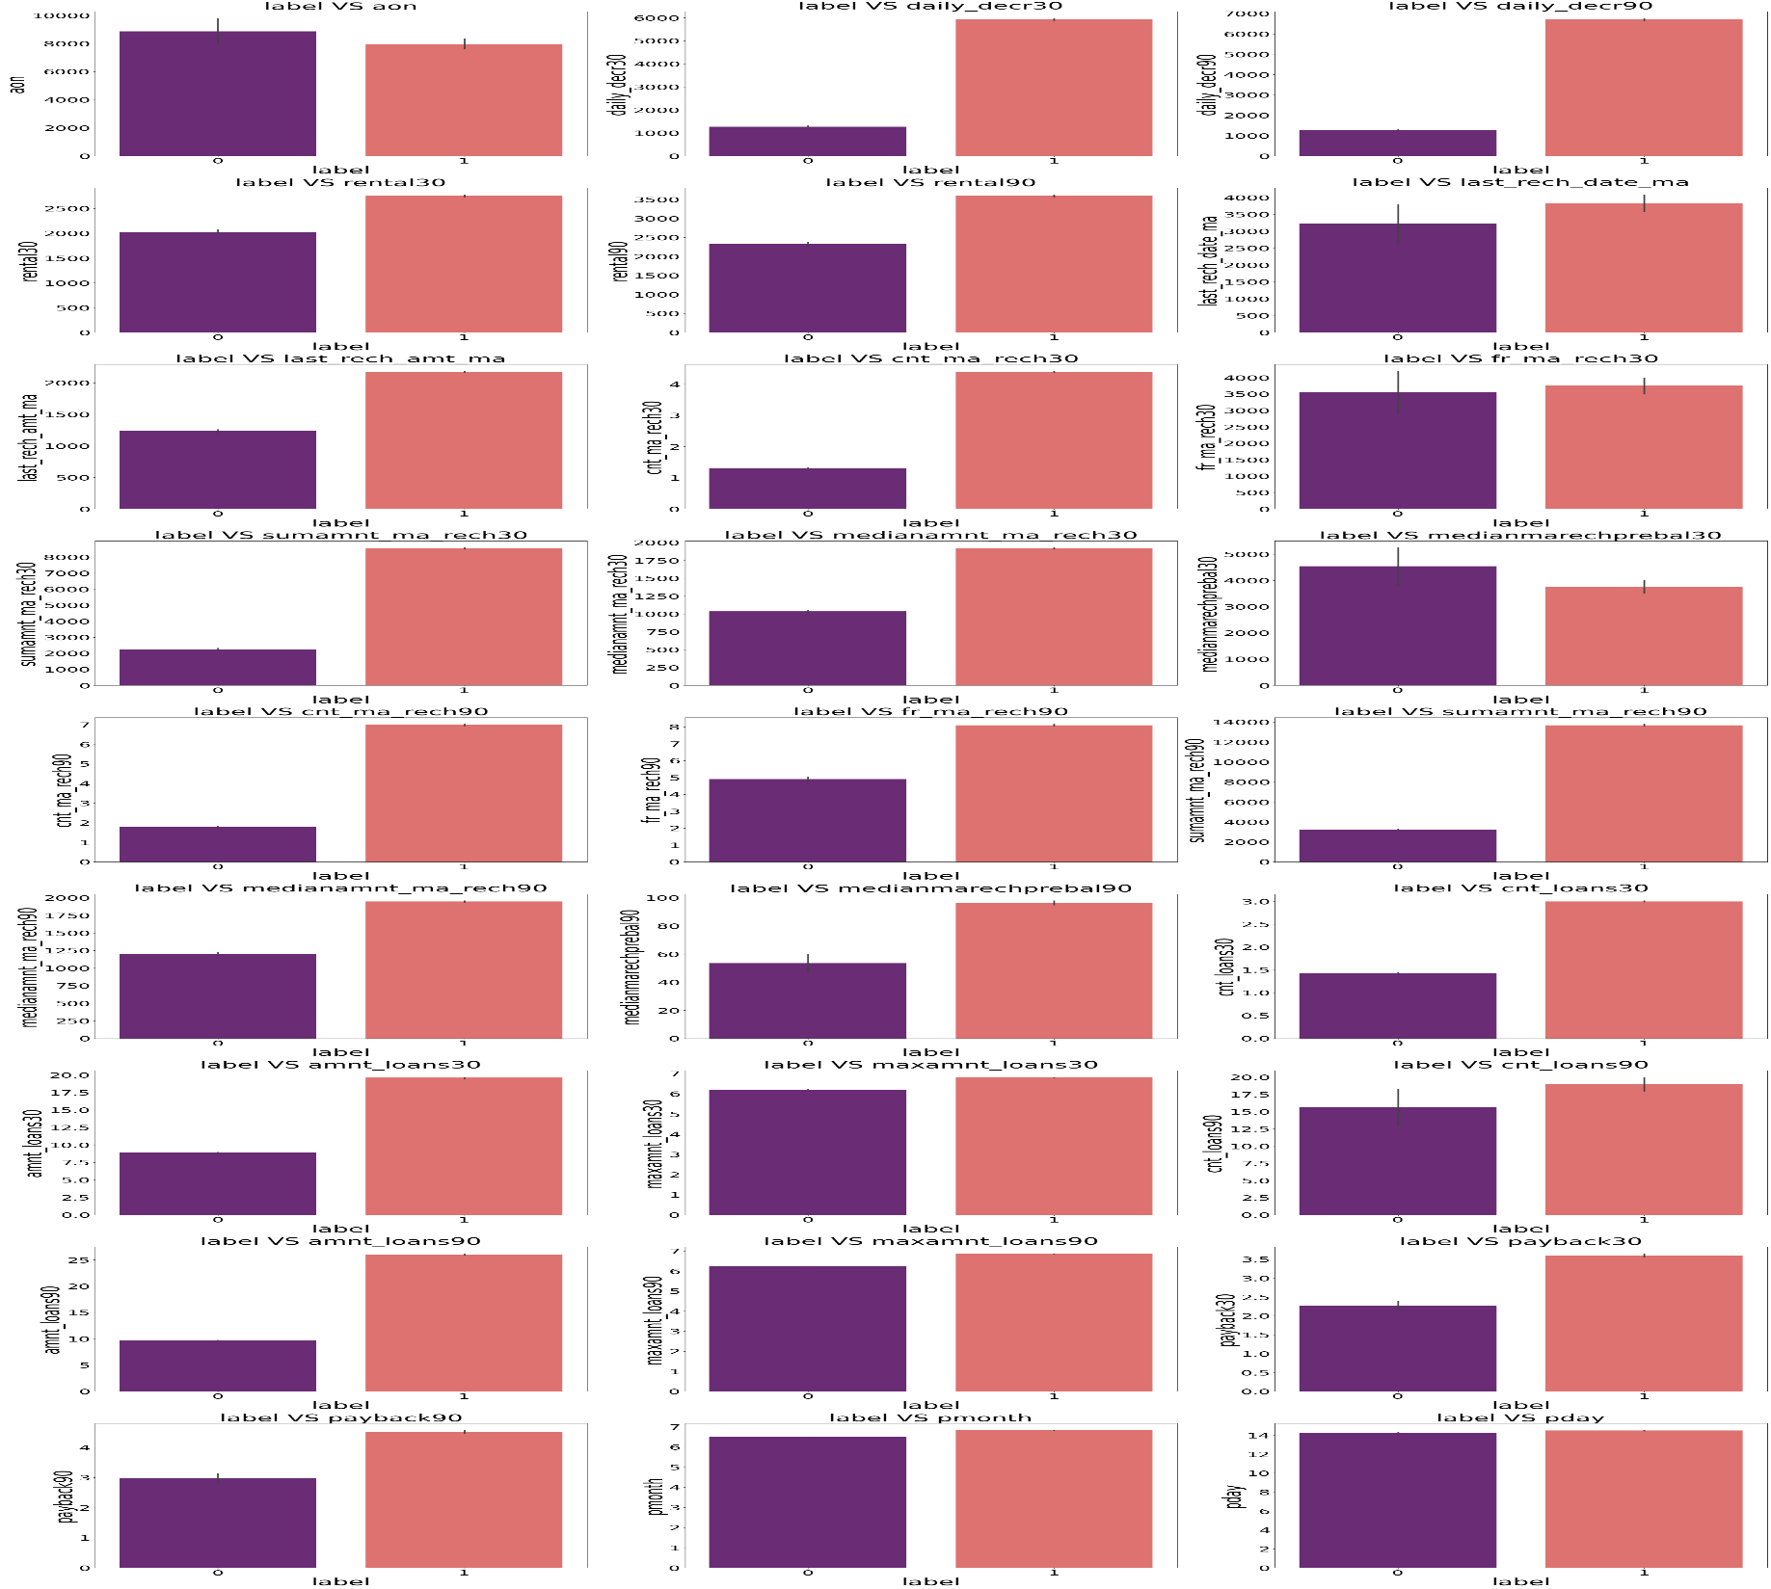
With the help of Bar Plot we are able to see the success and failure label data for the columns basically the feature data.

Slide 12
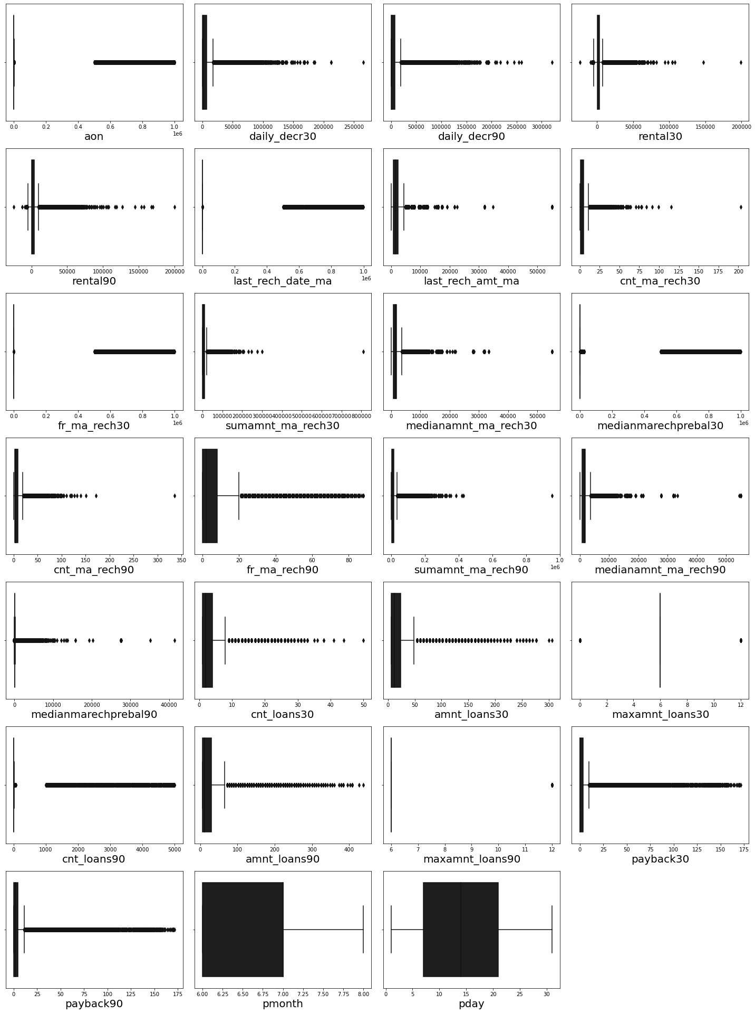
statistical representation of the all the numeric data columns.
In that have outliers so treat them with different methods

Slide 13

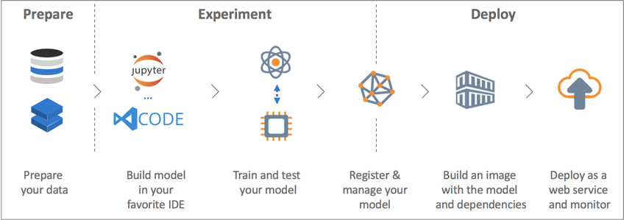
Model building
Built model which can be used to predict in terms of a probability for each loan transaction, whether the customer will be paying back the loaned amount within 5 days of insurance of loan.
In this case, Label ‘1’ indicates that the loan has been paid i.e. Non- defaulter, while, Label ‘0’ indicates that the loan has not been paid i.e. defaulter.

Slide 14
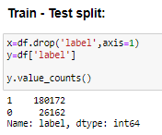
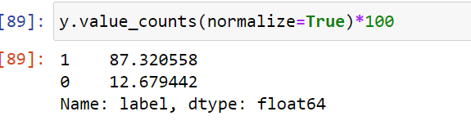
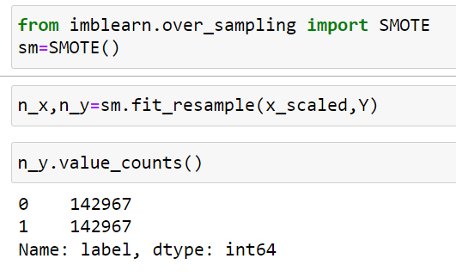
Splitting the train test data , there is imbalance of data. So, balance the data to remove the biasness from data.
This will give the better result during prediction.

Slide 15
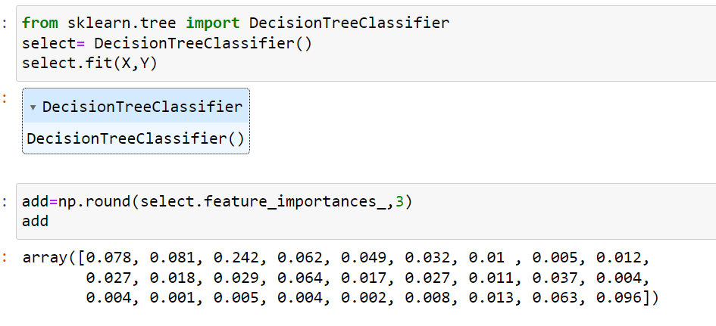
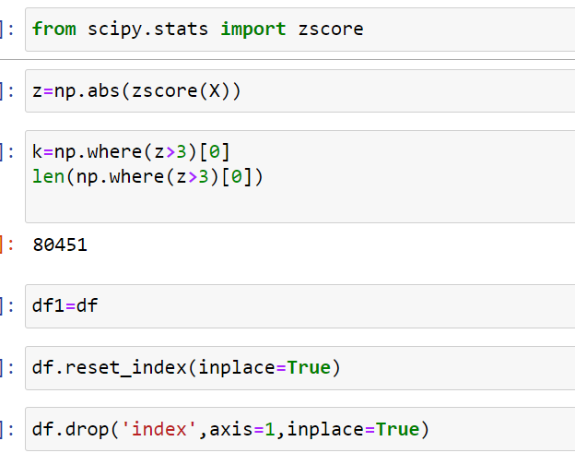
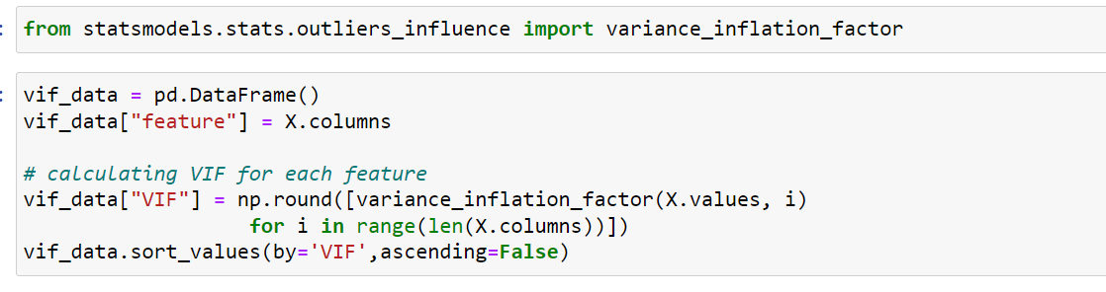
Here, we remove outliers using z_score
Checking VIF for multicollinearity problem
Using feature selection technique to select feature using Decision Tree Classifier

Slide 16
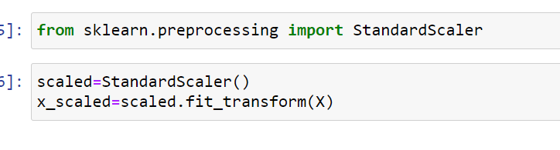
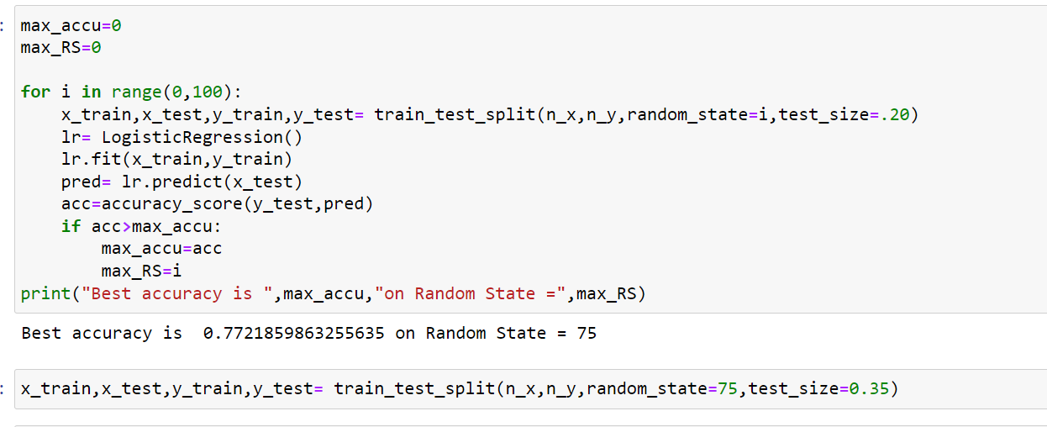
Data scaling:- scaling the data to bring the all the columns data into same scale, which is convenient for prediction
In other figure we see finding the best random state for training and testing

Slide 17
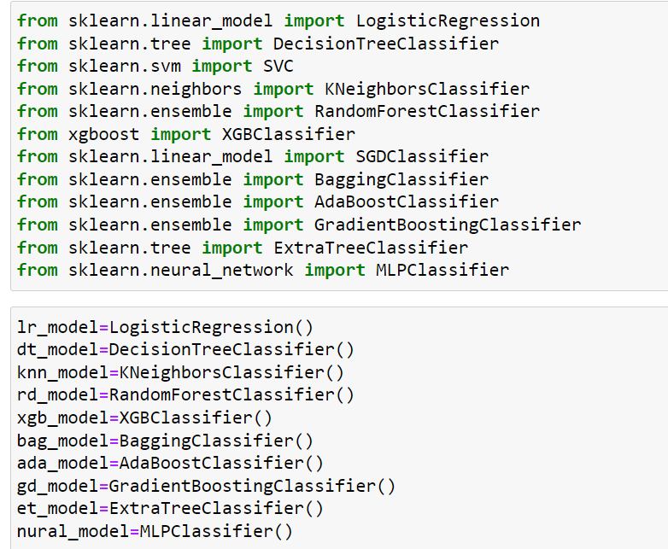
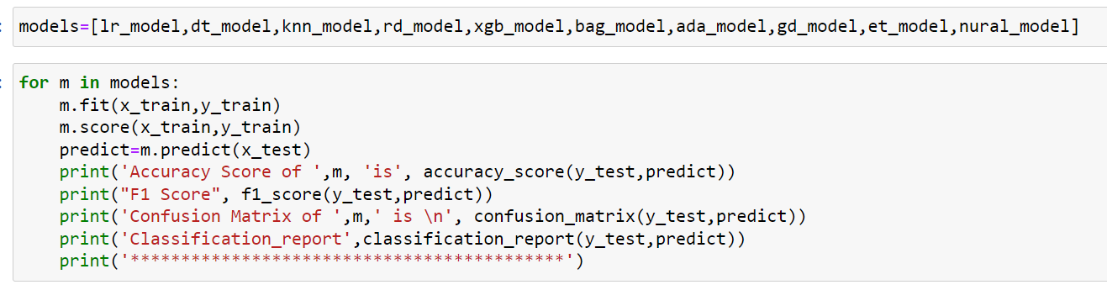
MODEL IMPORTING AND MODEL BUILDING
Importing the model use for prediction ,all the different type of models are here
And we train and test all the models

Slide 18
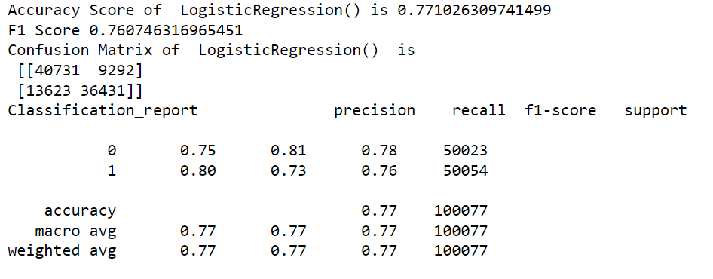
OUTPUT OF MODELS
PRECISION RECALL F1-SCORE SUPPORT
Logistic regression

Slide 19
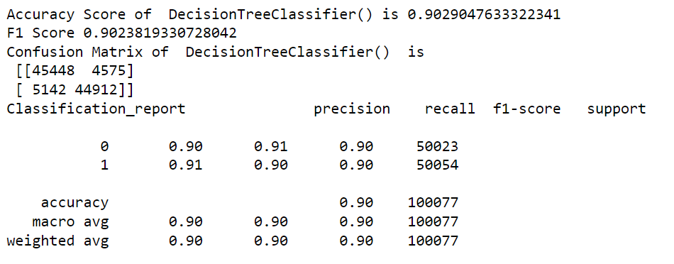
OUTPUT OF MODELS PRECISION RECALL F1-SCORE SUPPORT Decision Tree Classifier

Slide 20
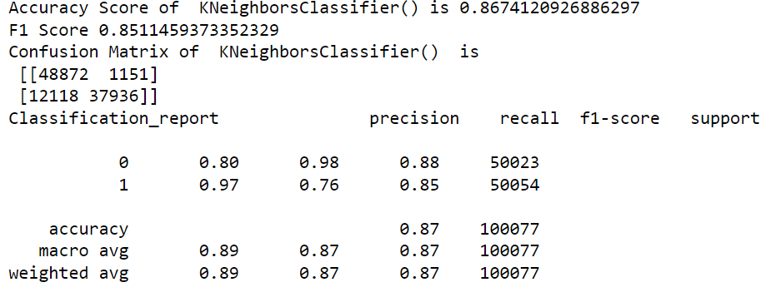
OUTPUT OF MODELS PRECISION RECALL F1-SCORE SUPPORT KNeighbor Classifier

Slide 21
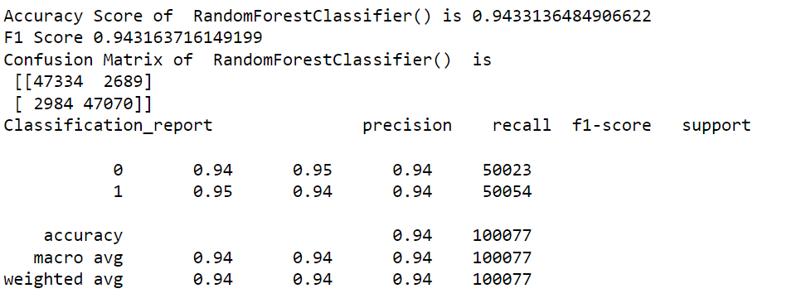
OUTPUT OF MODELS PRECISION RECALL F1-SCORE SUPPORT Random Tree Classifier

Slide 22
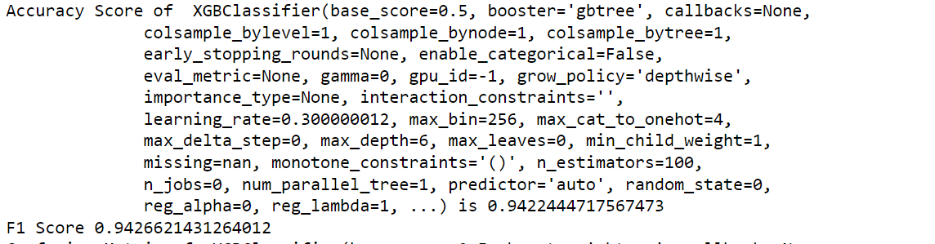
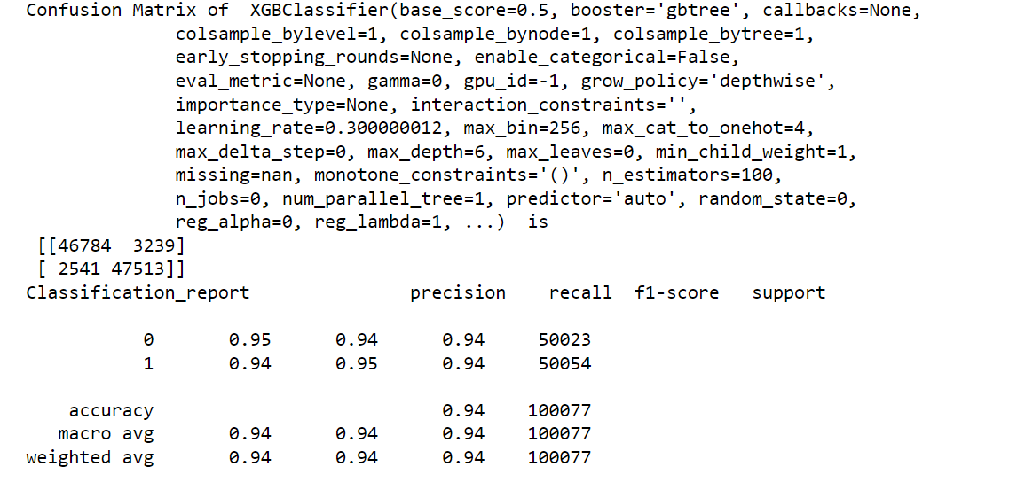
OUTPUT OF MODELS PRECISION RECALL F1-SCORE SUPPORT XGB Classifier

Slide 23
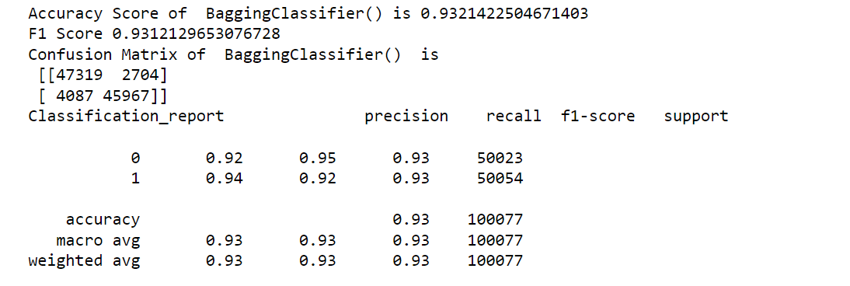
OUTPUT OF MODELS PRECISION RECALL F1-SCORE SUPPORT Bagging Classifier

Slide 24
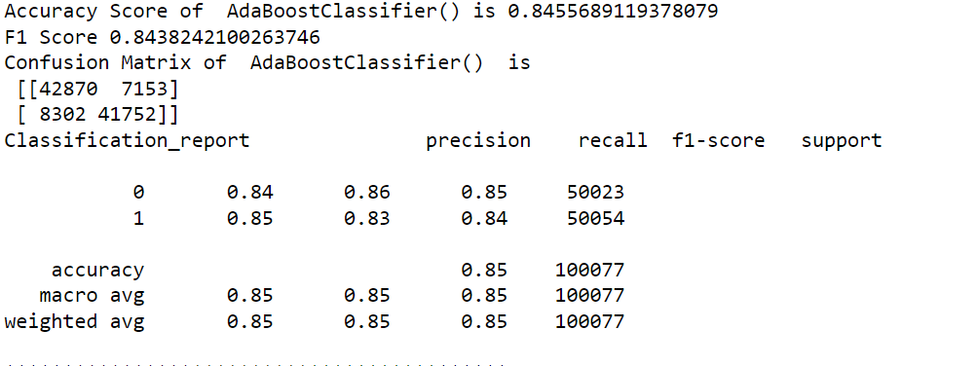
OUTPUT OF MODELS PRECISION RECALL F1-SCORE SUPPORT AdaBoost Classifier

Slide 25
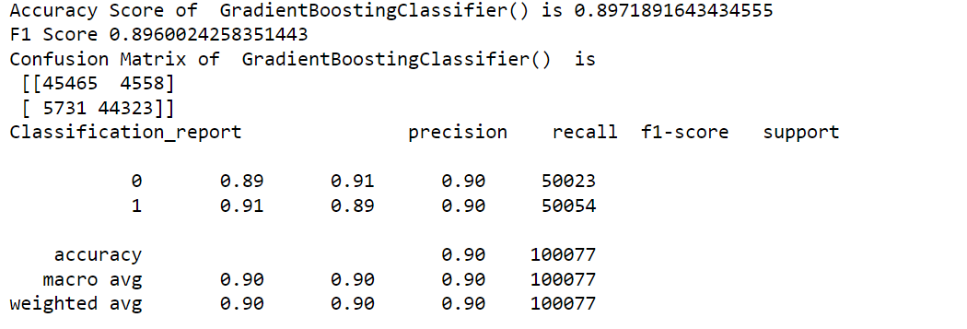
OUTPUT OF MODELS PRECISION RECALL F1-SCORE SUPPORT Gradient Boost Classifier

Slide 26
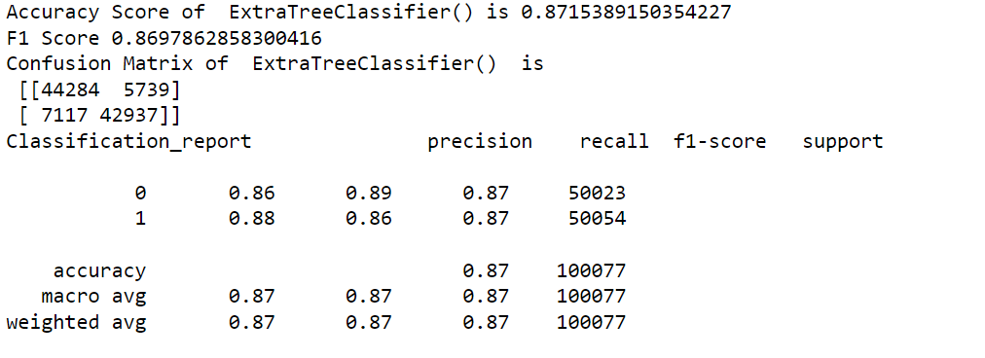
OUTPUT OF MODELS PRECISION RECALL F1-SCORE SUPPORT Extra Tree Classifier

Slide 27
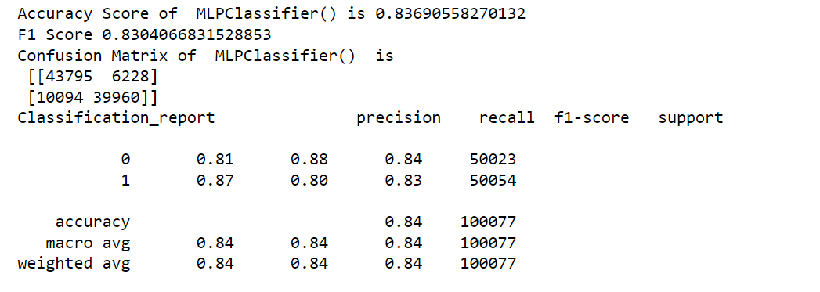
OUTPUT OF MODELS PRECISION RECALL F1-SCORE SUPPORT MLP Classifier

Slide 28
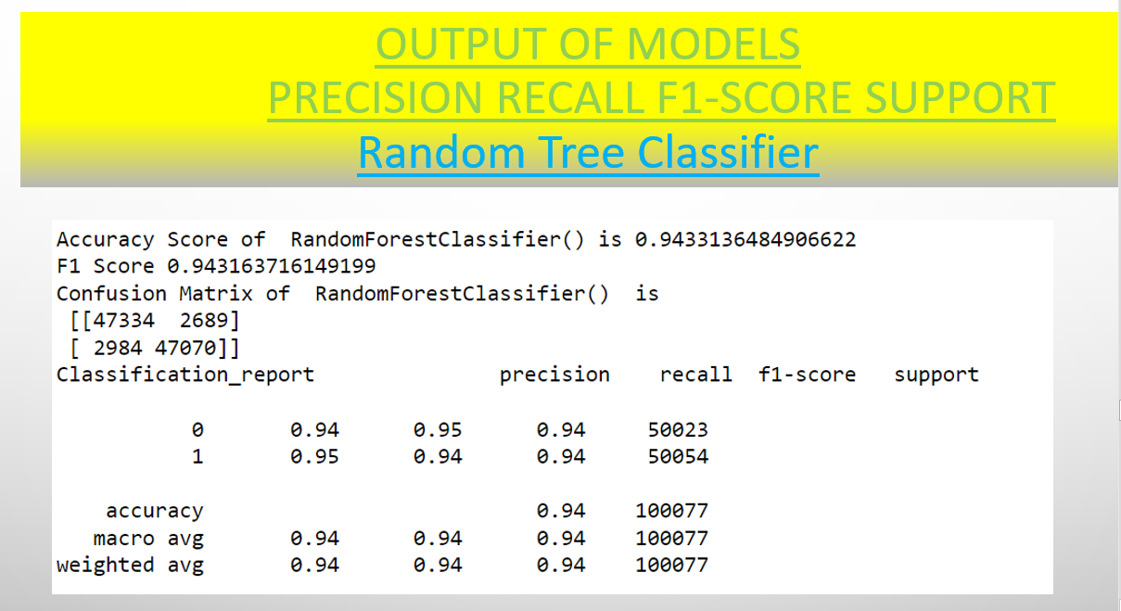
Selecting the model
We selected here Random tree
It is not overfitted model and can predict
At its best in real time as compared to any other model

Slide 29
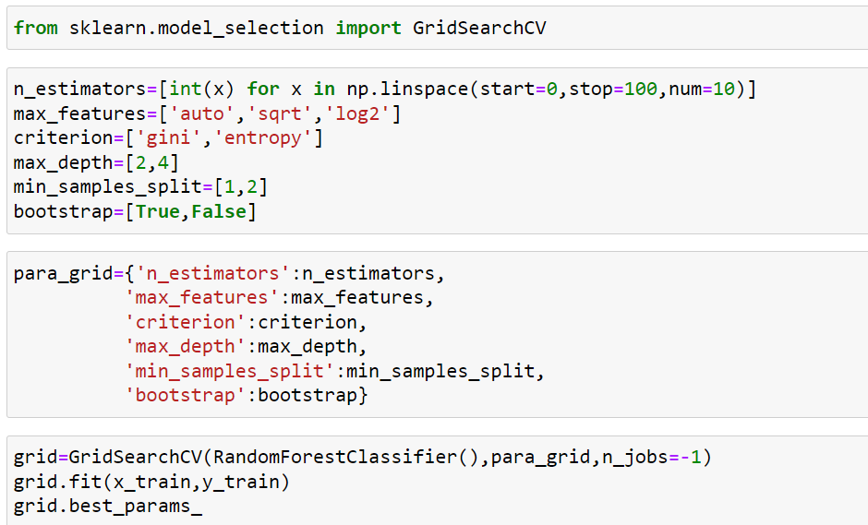
Hyperparameter tuning
It is done for to improve the accuracy score of model to predict more efficient
But, accuracy score do not improve after tuning. So, we proceed with default model
of Random Tree Classifier.

Slide 30
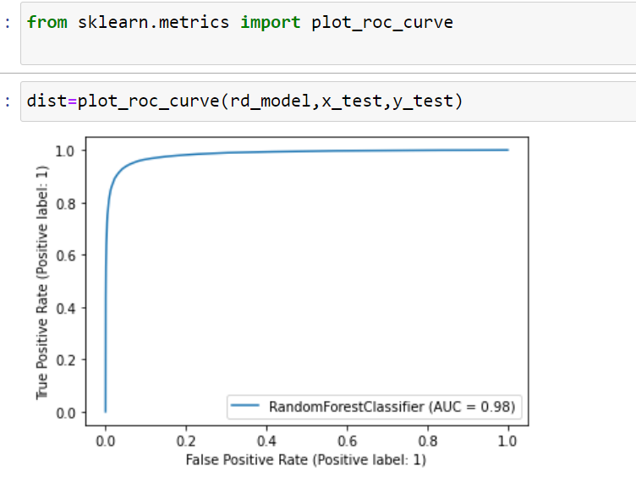
Plot roc auc curve
Plotting the graph to see AUC(Area under the curve)
AUC is 0.98 which is very good and accuracy score is 0.94
Also cross validation It do not fluctuate so much, it is less than 1%
So, we say that model is working at best capacity

Slide 31
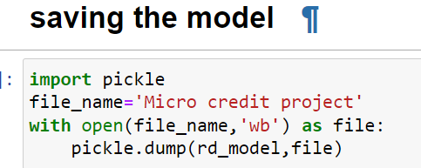
Finally we saving the model for further prediction

Slide 32
Conclusion
In this project report, evaluated individuals’ credit risk performance in a micro-finance environment using machine learning and deep learning techniques we have used machine learning algorithms to predict the micro credit defaulters. we have mentioned the step by step procedure to analyze the dataset and finding the correlation between the features. Thus we can select the features which are correlated to each other and are independent in nature.
These feature set were then given as an input to four algorithms and a hyper parameter tuning was done to the best model. Hence we calculated the performance of each model using different performance metrics and compared them based on these metrics. Then we have also saved the best model and predicted the label. It was good the predicted and actual values were almost same.

Slide 33
Limitation and scope
First draw back is the length of the dataset it is very huge and hard to handle.
Followed by more number of outliers and skewness these two will reduce our model accuracy.
Also, we have tried best to deal with outliers, skewness and zero values. So it looks quite good that we have achieved a accuracy of 94% even after dealing all these drawbacks.
Also, this study will not cover all Classification algorithms instead, it is focused on the chosen algorithm, starting from the basic ensemble techniques to the advanced ones

Slide 34


